Slide 1


Precision Oncology for Breast Cancer Treatment
UNIVERSITY OF GUADALAJARA - CUCEI
MCBCI - Metabolic Engineering
Presented by: Ing. Eduardo Ruiz Robles
Thesis Committee
Director:
Dr. Germán Andrés Preciat González
Codirector:
Dra. Martha Patricia Gallegos Arreola
Tutors:
Dr. Ernesto Borrayo Carbajal, Dra. Ana María Puebla Pérez, Dra. Patricia Martins Conde

Slide 2
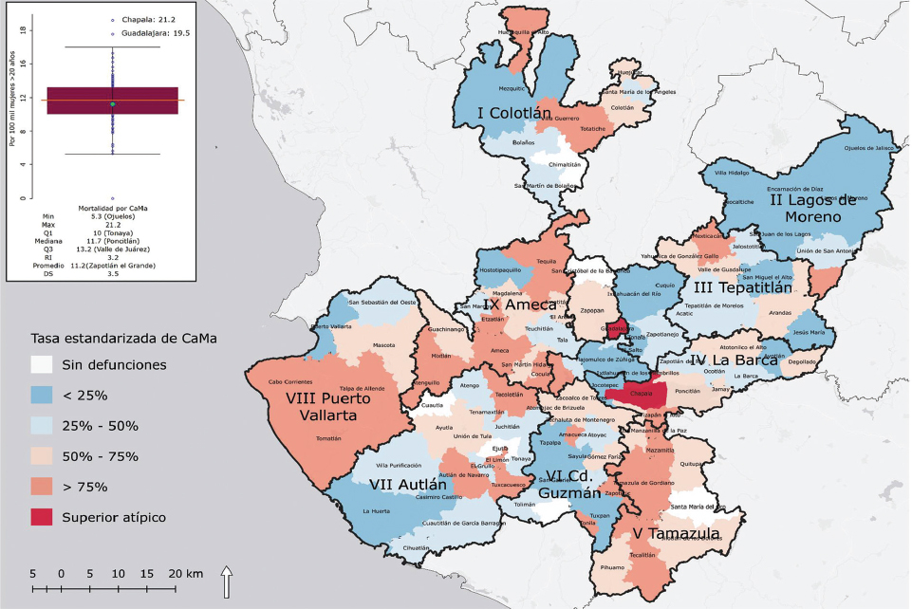
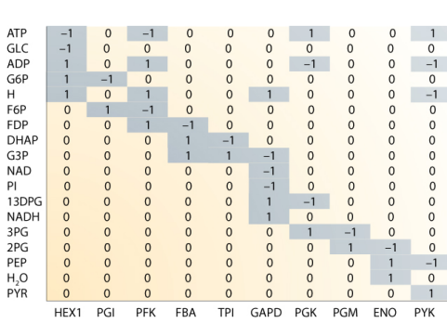
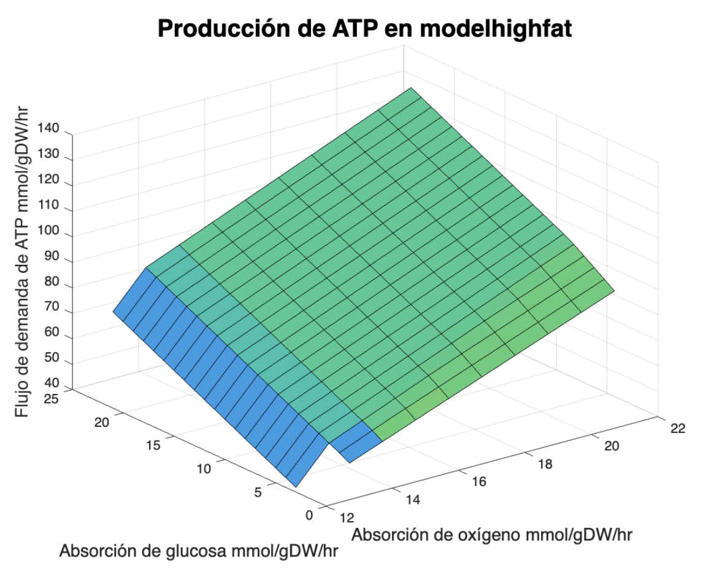
Summary
Precision Oncology for Breast Cancer Treatment
MCBCI - Metabolic Engineering
Introduction | Hypothesis | Objective | Methodology | Results | limitations | Conclusions
Results 📊
Data visualization with key graphs
Predictions of metabolic phenotypes
Introduction 📌
Brief project description
Main objective
Importance of the study
Methodology 🔬
Metabolic analysis approaches
Analysis of breast cells in MATLAB
Tools used (MATLAB, COBRA Toolbox, Python, knn)
Limitations 🚧 and conclusions ✅
Data integration
Computational Complexity
Highly Accurate GEMs

Slide 3
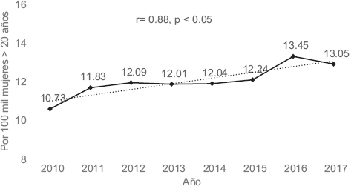
Justification
Precision Oncology for Breast Cancer Treatment
MCBCI - Metabolic Engineering
Introduction | Hypothesis | Objective | Methodology | Results | limitations | Conclusions
In 2020, there were over 685,000 deaths and 2.3 million new cases, according to the World Health Organization
Magnitude and geographic distribution of the standardized mortality rate for breast cancer by municipality of residence, Jalisco 2010-2017
Standardized mortality rate for breast cancer in Jalisco, 2010-2017
Igor M, et al (2020)
Igor M, et al (2020)
Notes:
Breast cancer has been the leading cause of death among women in Mexico since 2006. Between 2010 and 2017, Guadalajara and Chapala stood out with the highest mortality rates in the country, recording 21.2 and 19.5 deaths per 100,000 women over 20 years of age, respectively.
Breast cancer is the type of cancer that most affects women worldwide
In 2020, there were over 685,000 deaths and 2.3 million new cases, according to the World Health Organization

Slide 4
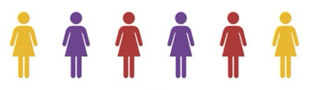
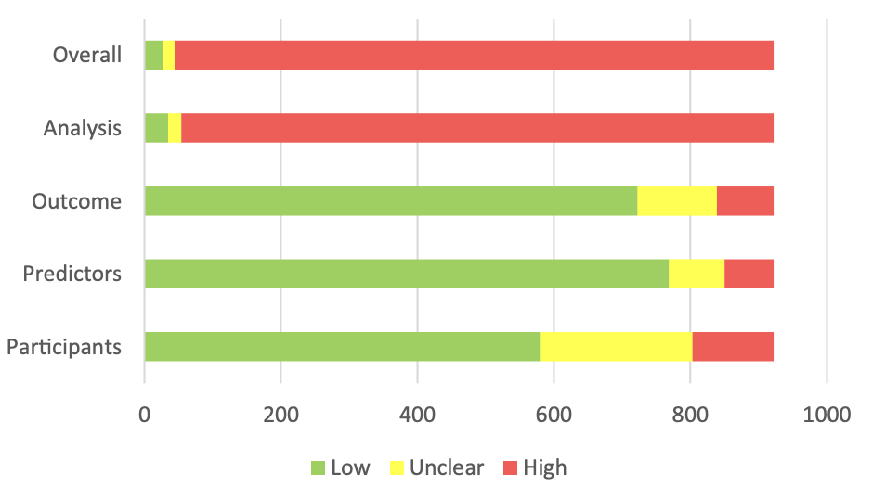
Problem statement
Precision Oncology for Breast Cancer Treatment
MCBCI - Metabolic Engineering
Introduction | Hypothesis | Objective | Methodology | Results | limitations | Conclusions
Breast Cancer
Clinical and genetic diversity
Difficulty to predict the pronostic in a patient
Systematic review of 534 studies published between 2010 and 2020, reporting the development of 922 different models
(2022 Tom A. et al.)
Notes:
In recent years, predictive models based on genomic data have been developed, although few achieve the necessary accuracy to be effectively implemented in clinical practice and public health. This is partly due to the fact that clinical data, such as blood biometrics, lipid profiles, electrolyte levels, electrocardiogram (ECG) records, and characteristics of the tumor microenvironment, introduce variability that affects the accuracy of models based solely on genomic data.
While clinical prediction models such as Predict, CancerMath, and the Nottingham Prognostic Index support decision-making regarding therapeutic strategies, many exhibit methodological flaws, biases, or a lack of transparency in their development and validation.
In a 2022 review of models used for clinical application conducted by Tom A. Hueting et al. in the Netherlands, over 95% presented a risk of bias, and 31% could not be applied to patients. By integrating non-omic patient data, the aim is to develop more personalized and accurate models to reduce this bias and make them applicable for treatment strategies

Slide 5
Precision Oncology for Breast Cancer Treatment
MCBCI - Metabolic Engineering
Introduction | Hypothesis | Objective | Methodology | Results | limitations | Conclusions
There is a significant correlation between metabolic phenotypes derived from genome-scale metabolic models (GEMs) and clinical characteristics of patients
Notes:
suggesting that there is variability in cellular metabolism related to the clinical information of each breast cancer patient

Slide 6
Precision Oncology for Breast Cancer Treatment
MCBCI - Metabolic Engineering
Introduction | Hypothesis | Objective | Methodology | Results | limitations | Conclusions
Develop personalized genome-scale metabolic models (GEMs) that integrate relevant clinical data to analyze their relationship with cancer progression and/or prognosis in patients

Slide 7
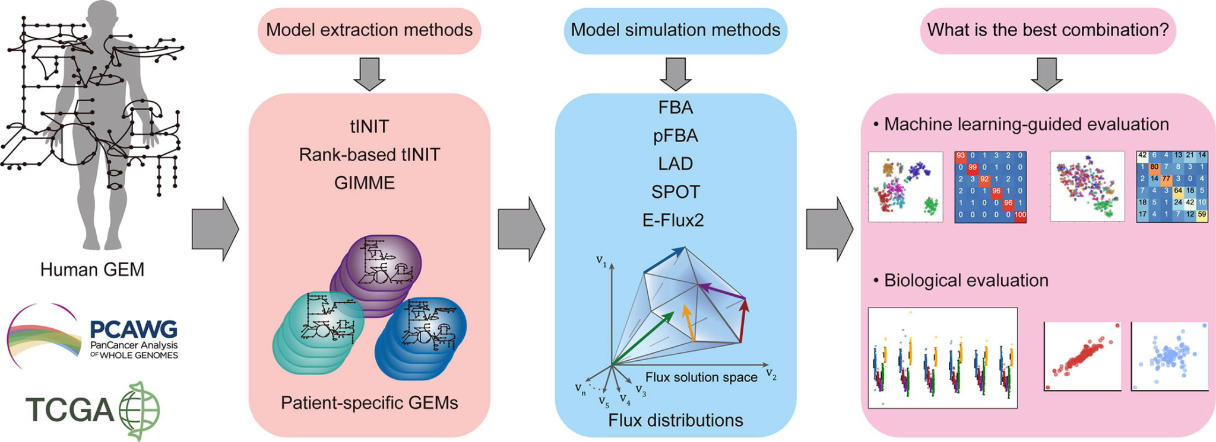
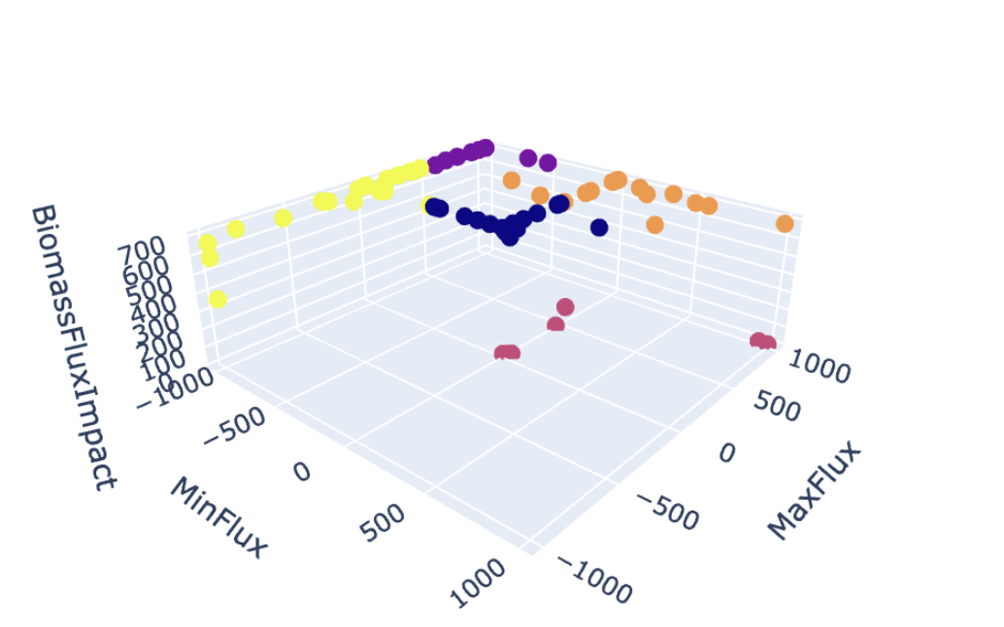



Precision Oncology for Breast Cancer Treatment
MCBCI - Metabolic Engineering
Introduction | Hypothesis | Objective | Methodology | Results | limitations | Conclusions
Preprocess Clinical Data for integration
Develop Personalize Metabolic Models
Adapt metabolic models in the tumor microenvironment
Identify correlations between clinical data and metabolic phenotypes
More precise diagnostic tests and individualized prognoses
Clinical Data

Slide 8


Precision Oncology for Breast Cancer Treatment
MCBCI - Metabolic Engineering
Introduction | Hypothesis | Objective | Methodology | Results | limitations | Conclusions
Genome Scale Models (GEMs)
Stoichiometric Matrix
S = Stoichiometric matrix
x = Flux vector
ub = Maximal vectors of reaction
CobraToolbox
Notes:
Cancer metabolism can be studied using metabolic models in Silico

Slide 9
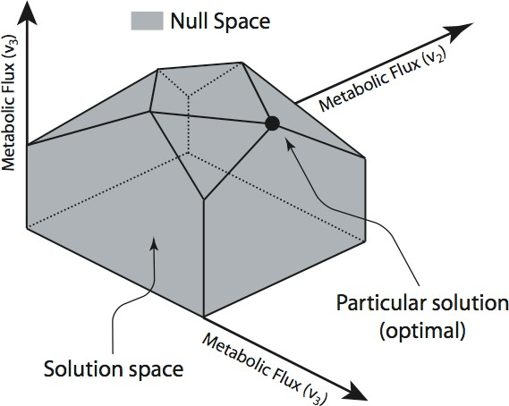
Precision Oncology for Breast Cancer Treatment
MCBCI - Metabolic Engineering
Introduction | Hypothesis | Objective | Methodology | Results | limitations | Conclusions
Flux Balance Analysis
Maximize Biomass
Oxygen demand
Understand how alterations in metabolic networks contribute to diseases, (in this case cancer)
Examples
Deletion of specific genes and predict its impact on cellular metabolism
Notes:
c^T * v

Slide 10
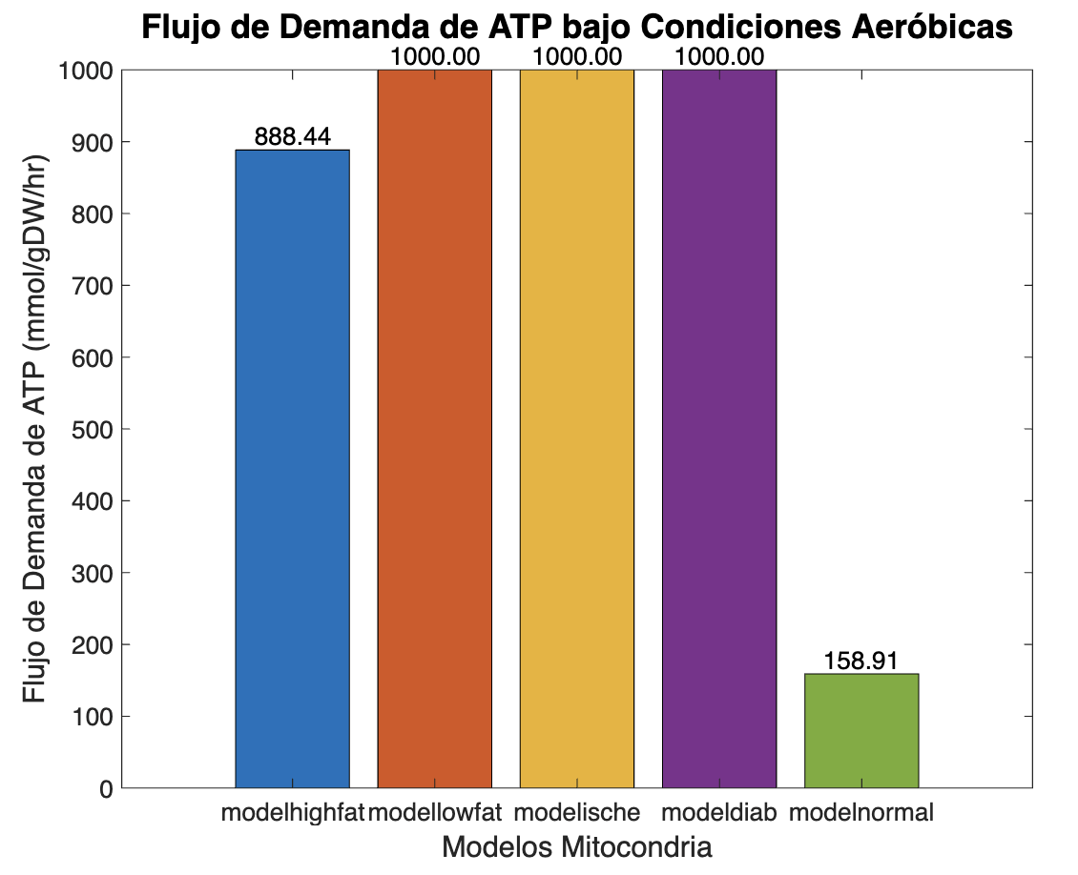
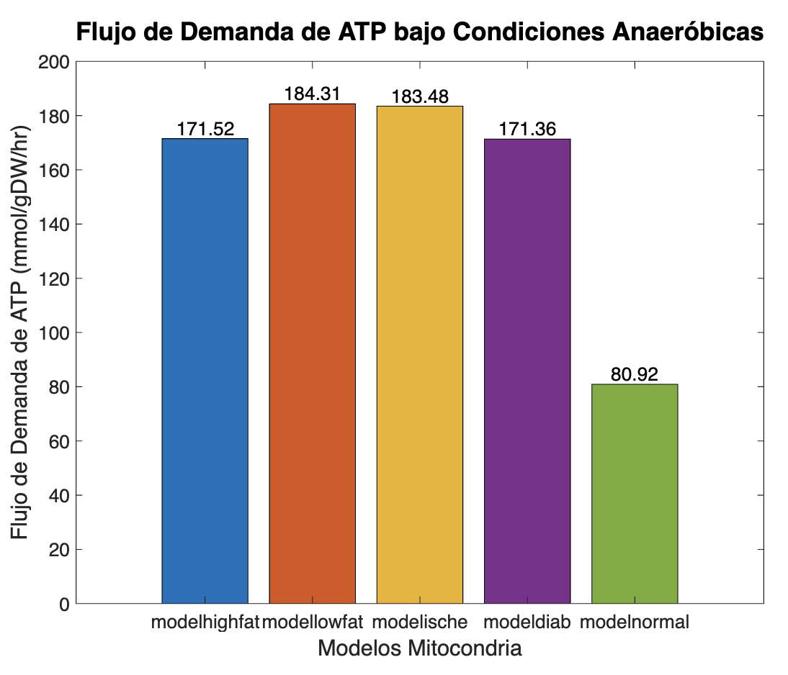
Precision Oncology for Breast Cancer Treatment
MCBCI - Metabolic Engineering
Introduction | Hypothesis | Objective | Methodology | Results | limitations | Conclusions
Calculation of ATP flux under aerobic and anaerobic conditions in a cardiac mitochondria
Notes:
Comparar ambos estados se puede comprender como las celulas optimizan su metabolismo dependiendo de la disponibilidad de oxigeno. Enfermedades como isquemia, infartos y cancer involucran regiones con bajo oxigeno (hipoxia)

Slide 11
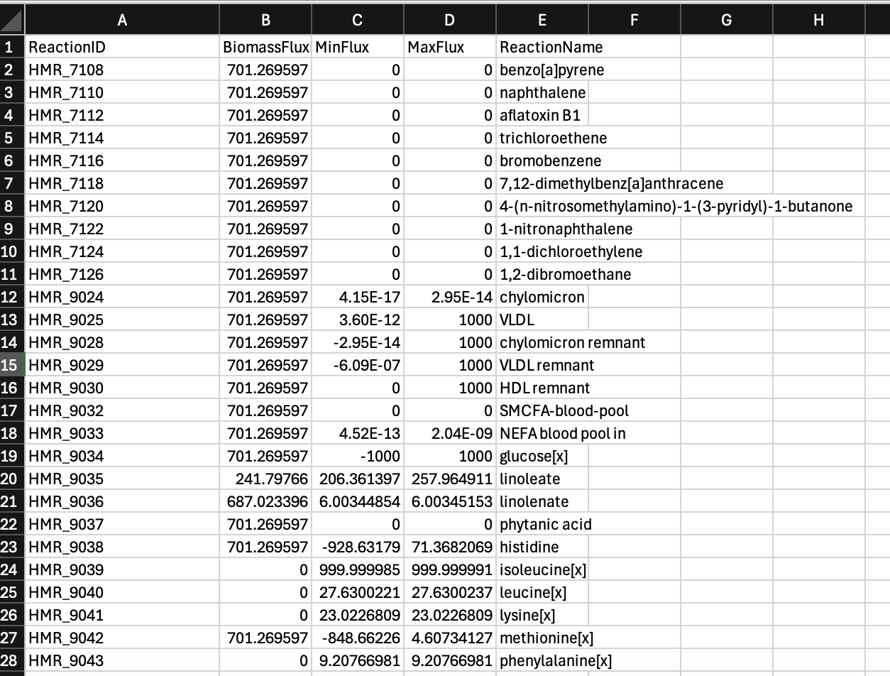
Precision Oncology for Breast Cancer Treatment
MCBCI - Metabolic Engineering
Introduction | Hypothesis | Objective | Methodology | Results | limitations | Conclusions
Breast cancer cell biomass optimization by closing each interchangeable reaction
Notes:
Closed interchangeable metabolics during optimality of biomass

Slide 12
Precision Oncology for Breast Cancer Treatment
MCBCI - Metabolic Engineering
Introduction | Hypothesis | Objective | Methodology | Results | limitations | Conclusions
K-means Clustering
Arginine = 0, the regulation of the ASL gene inhibits cell growth both in vitro and in vivo (Zou et al., 2024)
Leucine = 0, essential for biomass production
Linoleate dysregulation in propanoate leads to enhanced invasiveness of cancer cells (Gomes, A.P., Ilter, D., Low, V., et al., 2022)
https://colab.research.google.com/drive/1A1W0icxMlUsQjfJ-B4tRsTd_iincePWa?usp=sharing
Notes:
Found relevant aminoacids and fat acids that influence significantly in the biomass production and its effect on the progression of cancer

Slide 13
Grupo 1 (Metabolismo Central) | Grupo 2 (lípidos y neurotransmisores) | Grupo 3 (aminoácidos Esenciales) | Grupo 4 (Estrés oxidativo y energía) | Grupo 5 (Nucleótidos y azúcares)
Producción de energía y cofactores | Señalización y síntesis de membranas | Biosintesis de proteinas | Resistencia a estrés oxidativo | Síntesis de nucleótidos y metabolismo de carbohidratos
succinato, propanoato | Colesterol, serotonina | Leucina, Arginina, Lisina | O2, Glutamina, H2O2 | Citidina, Galactosa

Slide 14
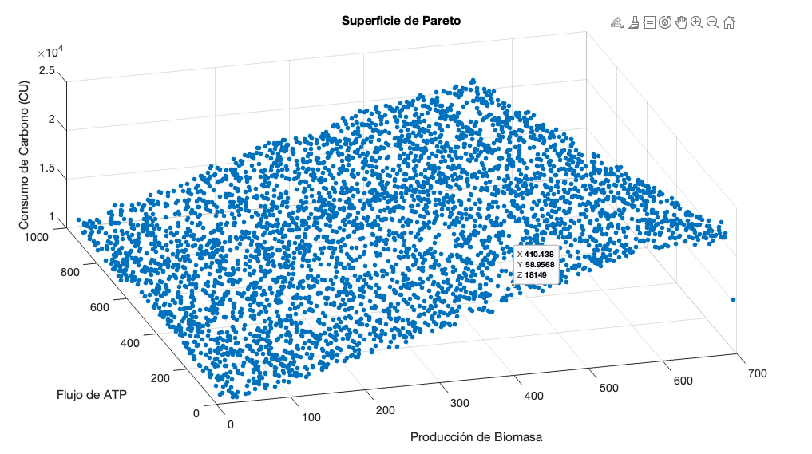
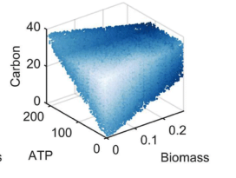
Precision Oncology for Breast Cancer Treatment
MCBCI - Metabolic Engineering
Introduction | Hypothesis | Objective | Methodology | Results | limitations | Conclusions
Pareto optimality
Notes:
Found relevant aminoacids and fat acids that influence significantly in the biomass production and its effect on the progression of cancer

Slide 15
Precision Oncology for Breast Cancer Treatment
MCBCI - Metabolic Engineering
Introduction | Hypothesis | Objective | Methodology | Results | limitations | Conclusions
improve oncology precision treatments for breast cancer
GEMs more precise and personalized, tailored to the microtumor environment
Predict treatment responses or identify biomarkers
Identified patterns and correlations between metabolic genotypes and clinical data

Slide 16
Precision Oncology for Breast Cancer Treatment
MCBCI - Metabolic Engineering
Introduction | Hypothesis | Objective | Methodology | Results | limitations | Conclusions
Determine which clinical data can be included in the Metabolic Models
Identified potential biomarkers for treatments, addressing the vast complexity of metabolism
Generalization of the models
Notes:
Determine which clinical data can be included in the Metabolic Models: The data will be on paper, so will need to be preprocess in computing format, also select the appropriate data to include in the models will require to investigate which of this data are related to cancer metabolism
Identified potential biomarkers for treatments, addressing the vast complexity of metabolism: Even if potential biomarkers are identified, validating their clinical relevance and impact on treatment can be challenging.
Generalization of the models – A model trained on specific data may not be directly applicable to other patient populations, limiting its broader clinical use.

Slide 17
Oncología de Precisión para el Tratamiento de Cáncer de Mama
MCBCI - Metabolic Engineering
Introduction | Hypothesis | Objective | Methodology | Results | limitations | Conclusions
-Create personalized metabolic models that integrate clinical information requires a comprehensive and detailed analysis to preprocess and select the data to include
-This approach is highly innovative, as current models often lack the incorporation of clinical variability, which can significantly impact the precision and reliability of the predictions
-The goal is to utilize this models will improve treatments outcomes for patients in Guadalajara
Notes:
Create personalized metabolic models that integrate clinical information requires a comprehensive and detailed analysis to preprocess and select the data to include. This approach is highly innovative, as current models often lack the incorporation of clinical variability, which can significantly impact the precision and reliability of the predictions. The goal is to utilize this models will improve treatments outcomes for patients in Guadalajara

Slide 18
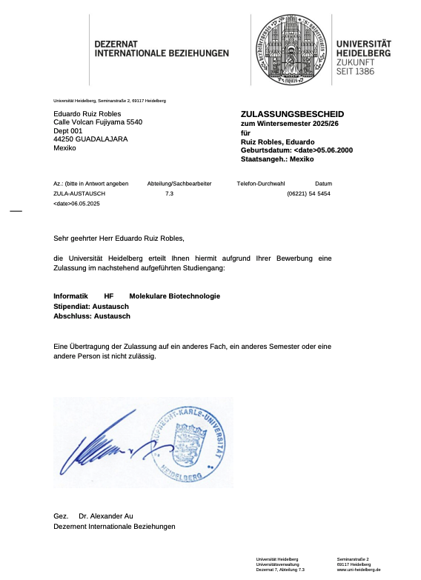


Academic exchange

Slide 19
Referencias
Zou, J., Mai, C., Lin, Z., Zhou, J., & Lai, G. (2024). Targeting metabolism of breast cancer and its implications in T cell immunotherapy. Frontiers in Immunology, 15. https://doi.org/10.3389/fimmu.2024.1381970
Gomes, A.P., Ilter, D., Low, V. et al. Altered propionate metabolism contributes to tumour progression and aggressiveness. Nat Metab 4, 435–443 (2022). https://doi.org/10.1038/s42255-022-00553-5

